Slide 1
Activation function

Slide 2
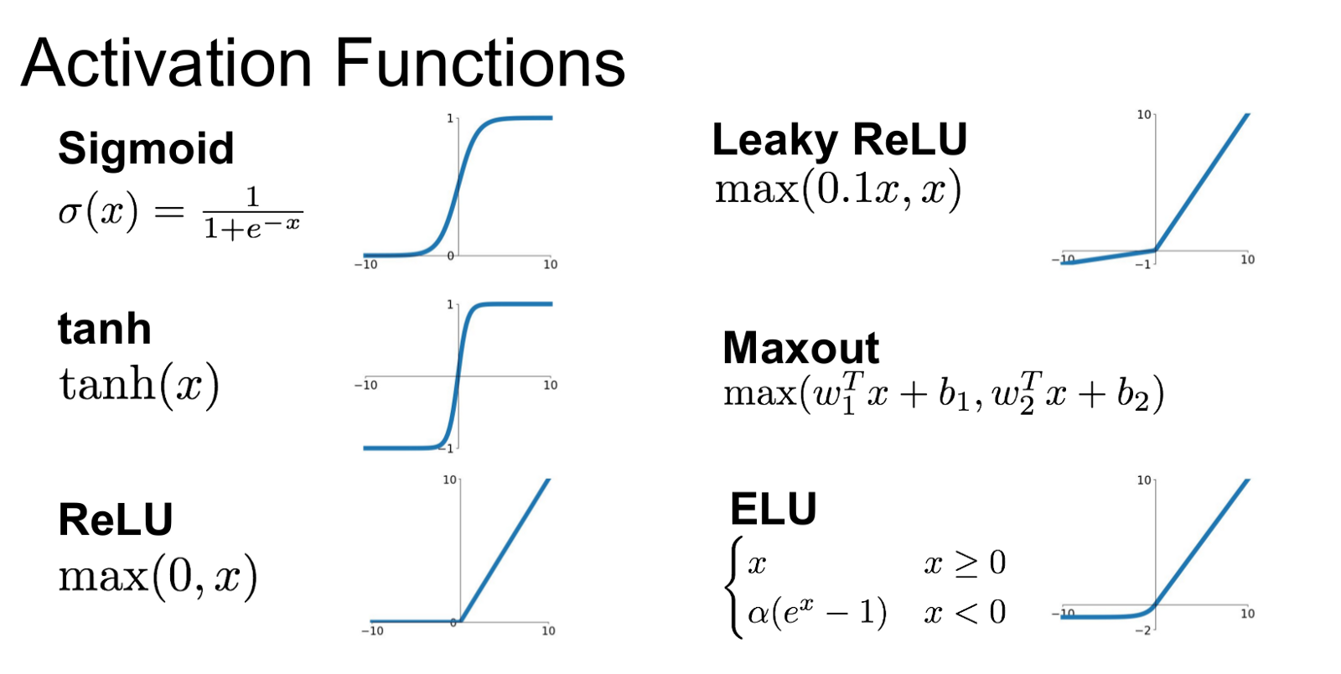
What is an activation function?
In artificial neural networks, the activation function of a node defines the output of that node, or neuron given an input of set of inputs. This output is then used as input for the next node and so on until a desired solution to the original problem is found.

Slide 3
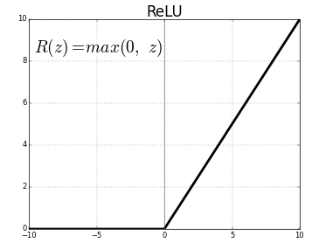
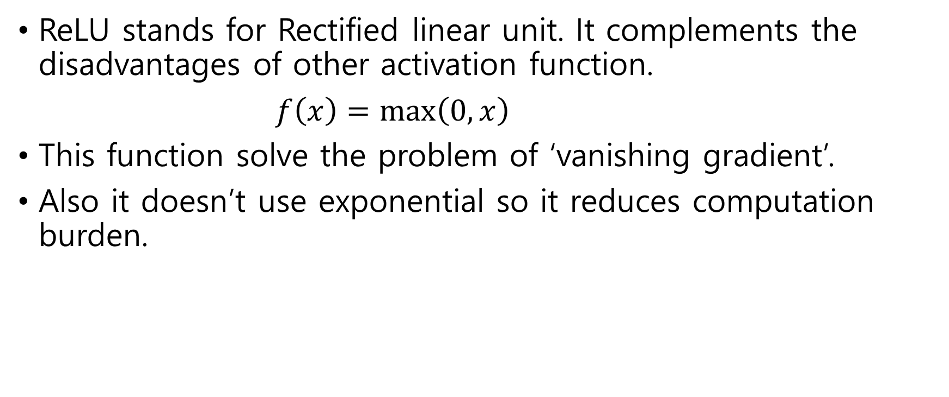
ReLU function
ReLU stands for Rectified linear unit. It complements the disadvantages of other activation function.
$f\left(x\right)=\max\left(0,x\right)$
This function solve the problem of ‘vanishing gradient’.
Also it doesn’t use exponential so it reduces computation burden.

Slide 4
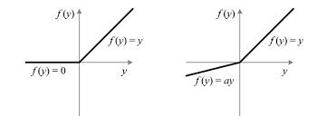
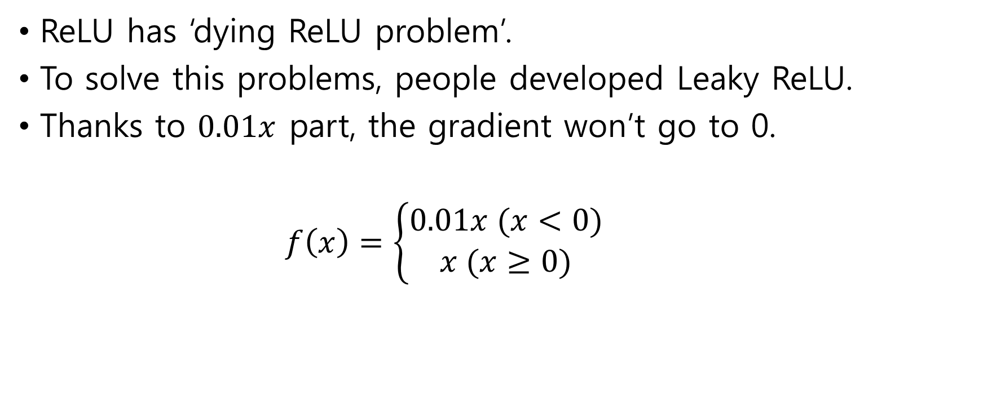
Leaky ReLU function
ReLU has ‘dying ReLU problem’.
To solve this problems, people developed Leaky ReLU.
Thanks to $0.01x$ part, the gradient won’t go to 0.
$f\left(x\right)=\left\{\begin{aligned}0.01x (x<0) \\ x (x≥0)\end{aligned}\right.$

Slide 5
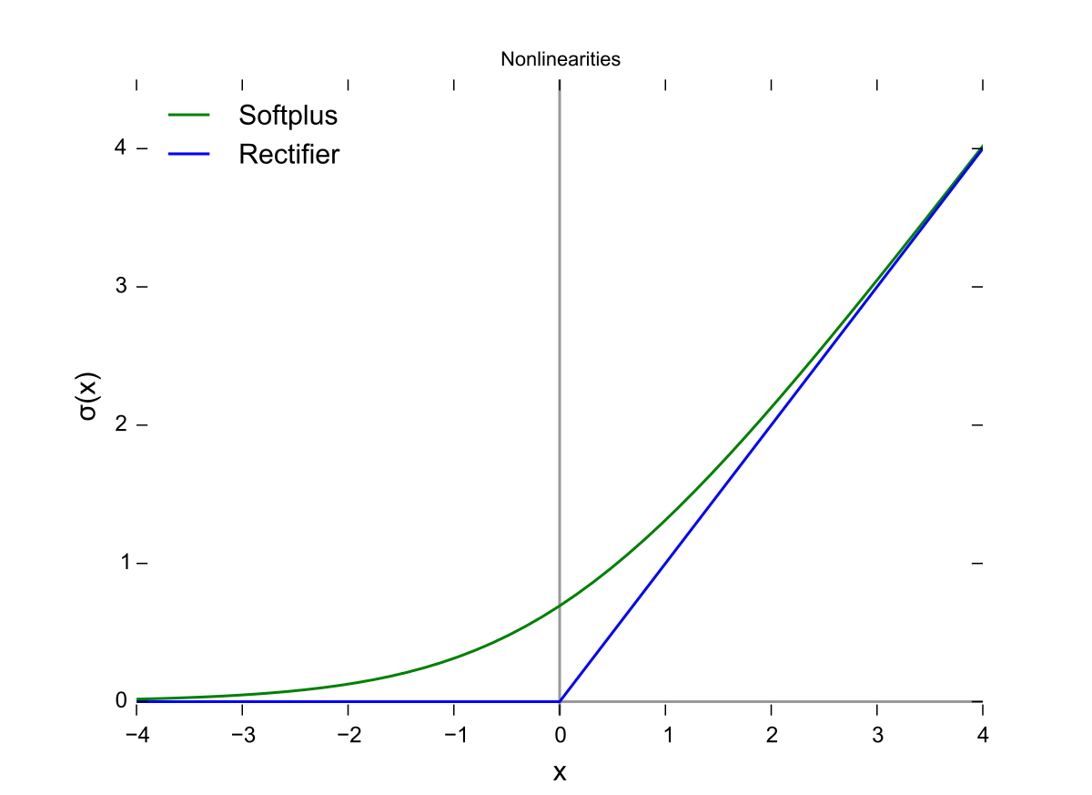

SoftPlus function
SoftPlus fuction is kind of smooth ReLU.
$f\left(x\right)=\ln{(1+e^{x}}$)
The smoothing and nonzero properties of the in gradient makes learning more effectively.

Slide 6
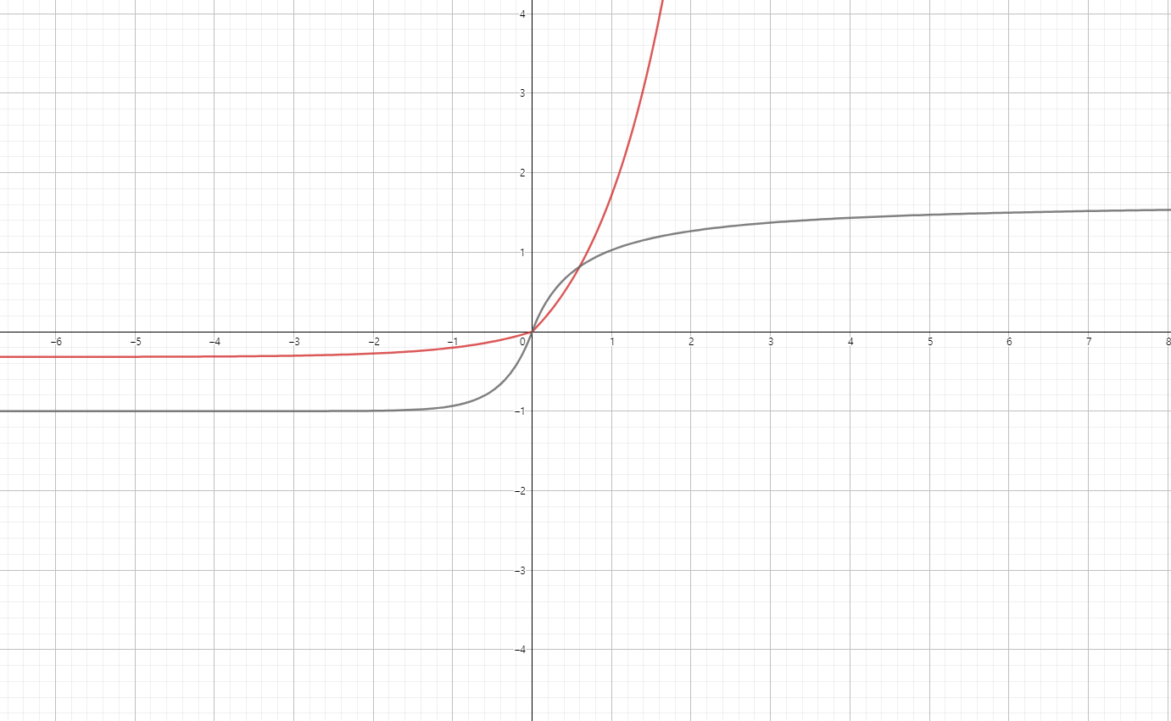

Our function(되는지 안되는지 모름)
With the help of 고원혁, we can make some new activation function.
$$f\left(x\right)=\left\{\begin{aligned}e^{x}−1 (x>0) \\ \frac{1}{π}\left(e^{x}−1\right) (x≤0)\end{aligned}\right.$$
$g\left(x\right)=\left\{\begin{aligned}−\frac{1}{x+\frac{1}{\sqrt{e}}}+\sqrt{e} (x>0) \\ e^{ex}−1 (x≤0)\end{aligned}\right.$

